Slide 1
Lecture 6
System of Linear Equations

Slide 2
Objective:
Analysis of some real life applications of system of linear equations.
To Solve the system of linear equations arising in the problem of network analysis and analysis of an electric circuit.

Slide 3
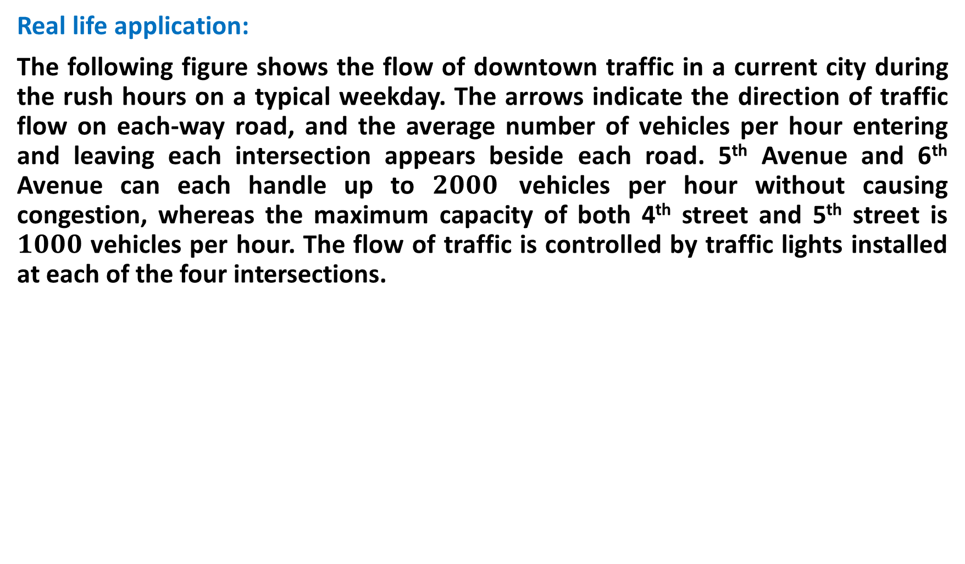
Real life application:
The following figure shows the flow of downtown traffic in a current city during the rush hours on a typical weekday. The arrows indicate the direction of traffic flow on each-way road, and the average number of vehicles per hour entering and leaving each intersection appears beside each road. 5th Avenue and 6th Avenue can each handle up to $2000$ vehicles per hour without causing congestion, whereas the maximum capacity of both 4th street and 5th street is $1000$ vehicles per hour. The flow of traffic is controlled by traffic lights installed at each of the four intersections.

Slide 4


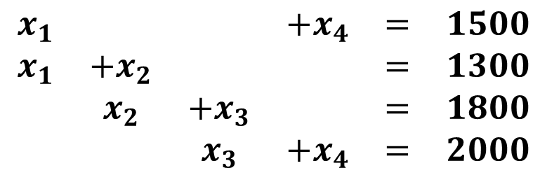
$$x_{1}, x_{2},x_{3},x_{4}.$$
Step 1: Write a general expression involving the rates of flow
To avoid congestion, all traffic entering an intersection must also leave that intersection. Applying this condition, we obtain the following equations:
Step 2: Write the above system of linear equation in the more standard form
$$\begin{matrix}1500=x_{1}+x_{4} \\ 1300=x_{1}+x_{2} \\ 1800=x_{2}+x_{3} \\ 2000=x_{3}+x_{4}\end{matrix}$$
$$\begin{matrix}x_{1} & & & +x_{4} & = & 1500 \\ x_{1} & +x_{2} & & & = & 1300 \\ & x_{2} & +x_{3} & & = & 1800 \\ & & x_{3} & +x_{4} & = & 2000\end{matrix}$$

Slide 5


Step 3: Write the augmented matrix
Step 4: Using the Gauss-Jordan elimination method, we obtain
$$\left[\begin{matrix}1 & 0 & 0 & 1 \\ 1 & 1 & 0 & 0 \\ 0 & 1 & 1 & 0 \\ 0 & 0 & 1 & 1\end{matrix} | \begin{matrix}1500 \\ 1300 \\ 1800 \\ 2000\end{matrix}\right]$$
$$\left[\begin{matrix}1 & 0 & 0 & 1 \\ 0 & 1 & 0 & −1 \\ 0 & 0 & 1 & 1 \\ 0 & 0 & 0 & 0\end{matrix} | \begin{matrix}1500 \\ −200 \\ 2000 \\ 0\end{matrix}\right]$$

Slide 6
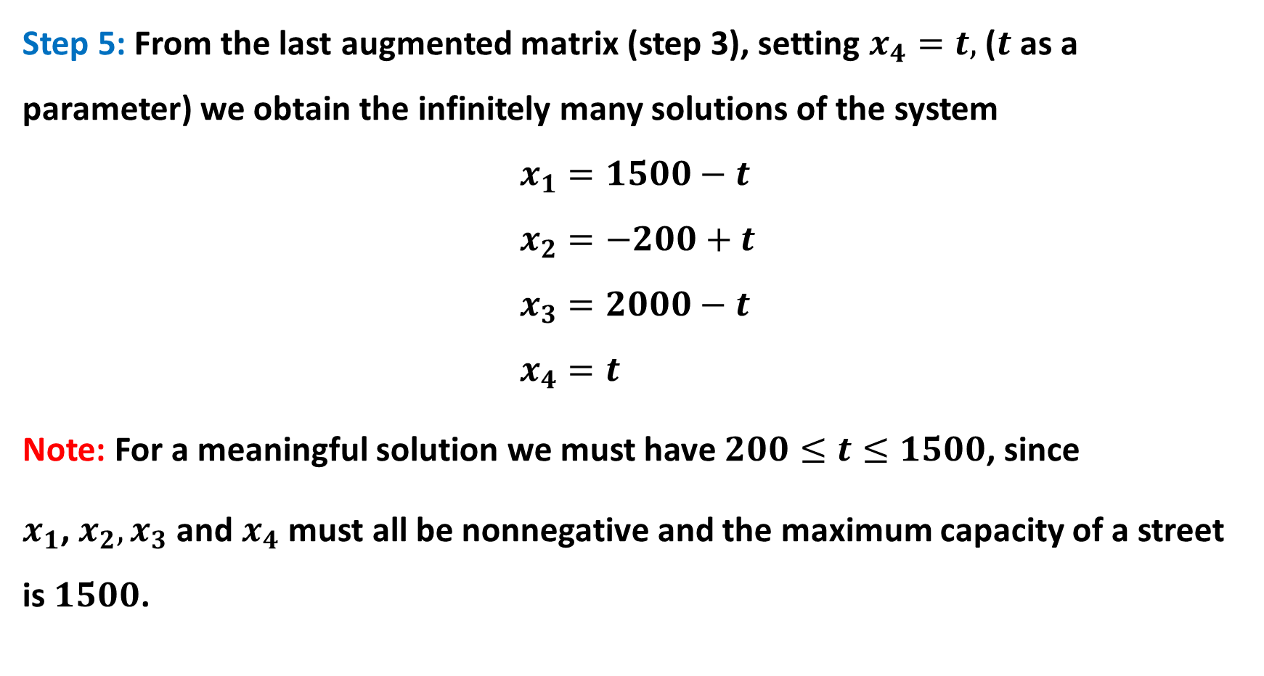
Step 5: From the last augmented matrix (step 3), setting $x_{4}=t,$ ($t$ as a parameter) we obtain the infinitely many solutions of the system
$$x_{1}=1500−t \\ x_{2}=−200+t \\ x_{3}=2000−t \\ x_{4}=t$$
Note: For a meaningful solution we must have $200≤t≤1500$, since
$x_{1}$, $x_{2},x_{3}$ and $x_{4}$ must all be nonnegative and the maximum capacity of a street is $1500$.

Slide 7
Some Related Exercise:
2.
Determine the general flow pattern for the network.

Slide 8
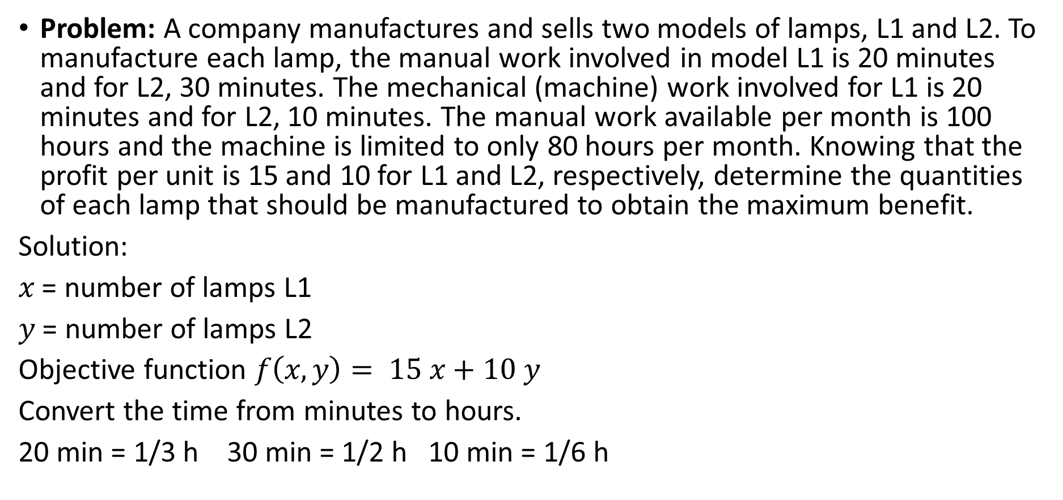
Linear Programming Problem
Problem: A company manufactures and sells two models of lamps, L1 and L2. To manufacture each lamp, the manual work involved in model L1 is 20 minutes and for L2, 30 minutes. The mechanical (machine) work involved for L1 is 20 minutes and for L2, 10 minutes. The manual work available per month is 100 hours and the machine is limited to only 80 hours per month. Knowing that the profit per unit is 15 and 10 for L1 and L2, respectively, determine the quantities of each lamp that should be manufactured to obtain the maximum benefit.
Solution:
$x$ = number of lamps L1
$y$ = number of lamps L2
Objective function $f\left(x,y\right)= 15 x+10 y$
Convert the time from minutes to hours.
20 min = 1/3 h 30 min = 1/2 h 10 min = 1/6 h

Slide 9

Linear Programming Problem
Writing the constraints as a system of inequalities we get
$$\frac{1}{3}x + \frac{1}{2}y ≤ 100$$
$$\frac{1}{3}x + \frac{1}{6}y ≤ 80$$
As the numbers of lamps are natural numbers, we have $x ≥ 0 \& y ≥ 0$
Represent the constraints graphically.
As $x ≥ 0 \& y ≥ 0$, work in the first quadrant.
 | L1 | L2 | Time
Manual | 1/3 | 1/2 | 100
Machine | 1/3 | 1/6 | 80

Slide 10
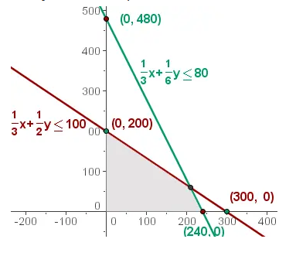
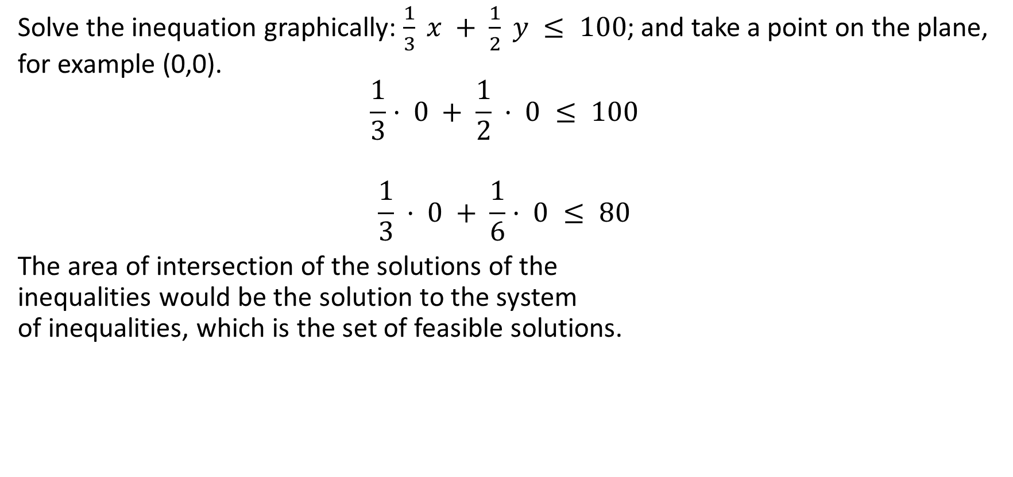
Linear Programming Problem
Solve the inequation graphically: $\frac{1}{3} x + \frac{1}{2} y ≤ 100$; and take a point on the plane, for example (0,0).
$$\frac{1}{3}· 0 + \frac{1}{2} · 0 ≤ 100$$
$$\frac{1}{3} · 0 + \frac{1}{6}· 0 ≤ 80$$
The area of intersection of the solutions of the inequalities would be the solution to the system of inequalities, which is the set of feasible solutions.

Slide 11
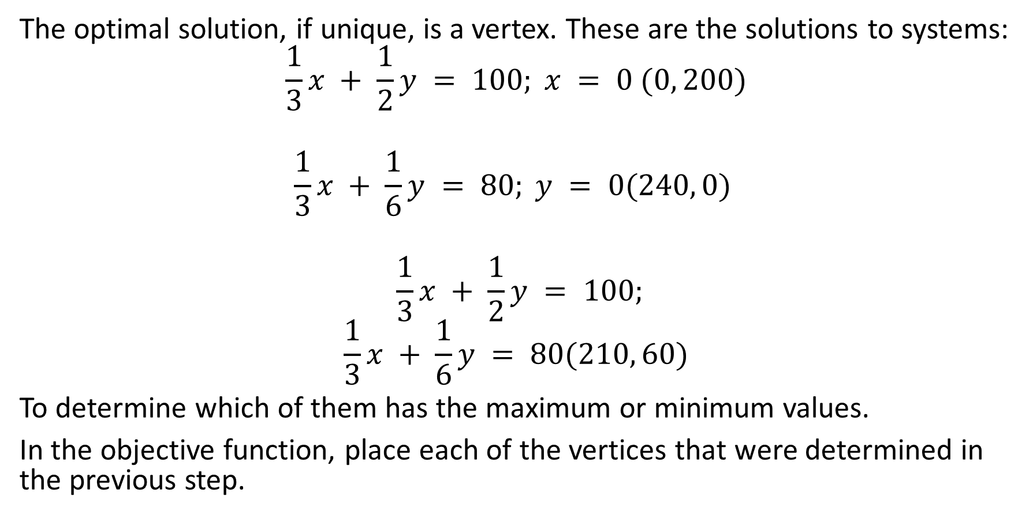
Linear Programming Problem
The optimal solution, if unique, is a vertex. These are the solutions to systems:
$$\frac{1}{3}x + \frac{1}{2}y = 100; x = 0 (0, 200)$$
$$\frac{1}{3}x + \frac{1}{6}y = 80; y = 0(240, 0)$$
$$\frac{1}{3}x + \frac{1}{2}y = 100;$$
$$\frac{1}{3}x + \frac{1}{6}y = 80(210, 60)$$
To determine which of them has the maximum or minimum values.
In the objective function, place each of the vertices that were determined in the previous step.

Slide 12
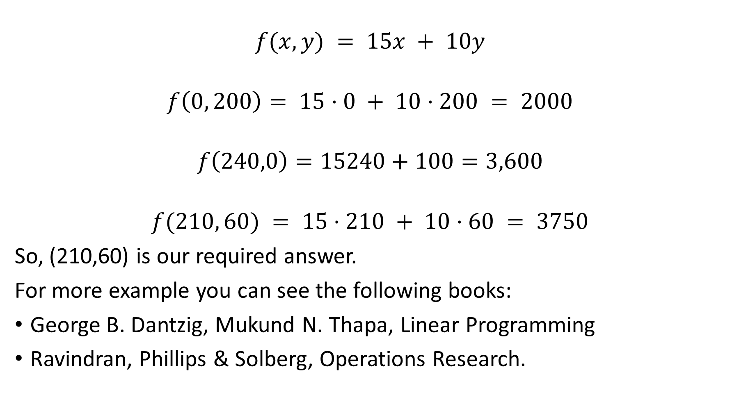
Linear Programming Problem
$$f(x, y) = 15x + 10y$$
$$f\left(0, 200\right)= 15·0 + 10·200 = 2000$$
$$f\left(240,0\right)=15240+100=3,600$$
$$f(210, 60) = 15·210 + 10·60 = 3750$$
So, (210,60) is our required answer.
For more example you can see the following books:
George B. Dantzig, Mukund N. Thapa, Linear Programming
Ravindran, Phillips & Solberg, Operations Research.

Slide 13
Some related exercise:
A company makes two products (X and Y) using two machines (A and B). Each unit of X that is produced requires 50 minutes processing time on machine A and 30 minutes processing time on machine B. Each unit of Y that is produced requires 24 minutes processing time on machine A and 33 minutes processing time on machine B.
At the start of the current week there are 30 units of X and 90 units of Y in stock. Available processing time on machine A is forecast to be 40 hours and on machine B is forecast to be 35 hours.
The demand for X in the current week is forecast to be 75 units and for Y is forecast to be 95 units. Company policy is to maximise the combined sum of the units of X and the units of Y in stock at the end of the week.
A store has requested a manufacturer to produce pants and sports jackets.
For materials, the manufacturer has of cotton textile and of polyester. Every pair of pants (1 unit) needs of cotton and of polyester. Every jacket needs of cotton and of polyester. The price of the pants is fixed at $50 and the jacket, $40. What is the number of pants and jackets that the manufacturer must give to the stores so that these items obtain a maximum sale?

Slide 14
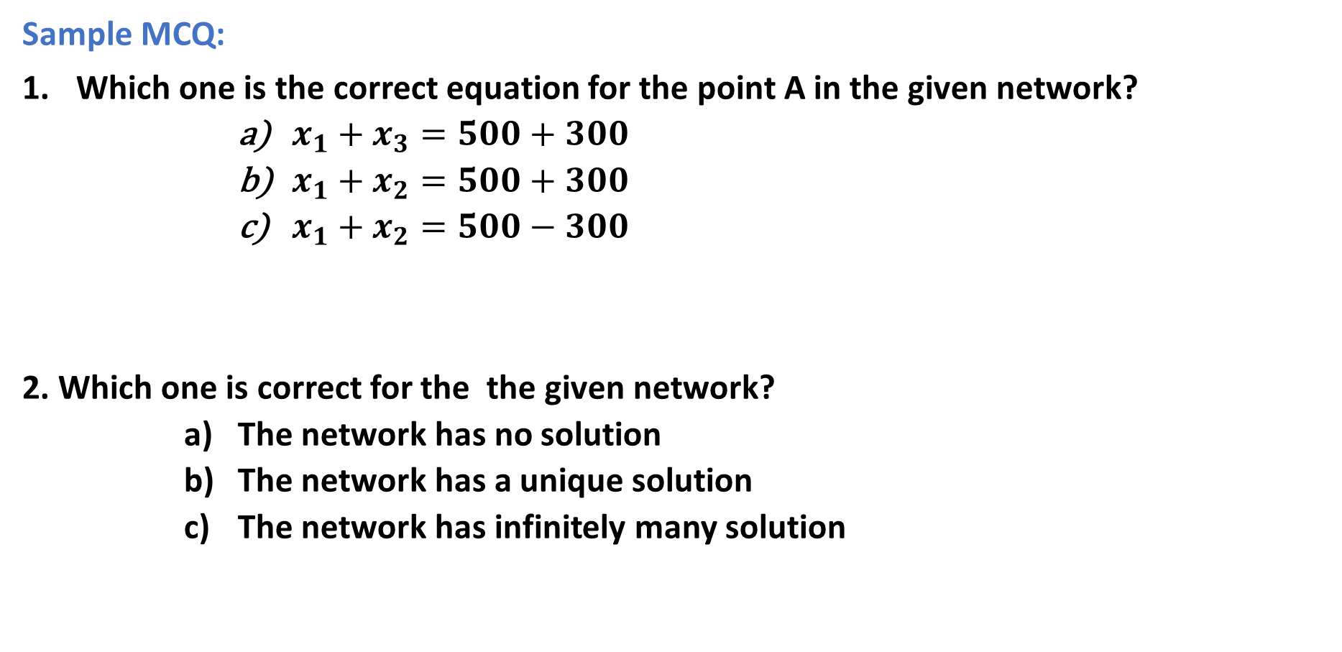
Sample MCQ:
Which one is the correct equation for the point A in the given network?
$x_{1}+x_{3}=500+300$
$x_{1}+x_{2}=500+300$
$x_{1}+x_{2}=500−300$
2. Which one is correct for the the given network?
The network has no solution
The network has a unique solution
The network has infinitely many solution

Slide 15
Outcome:
Some real life applications of system of linear equations are observed and analyzed.
System of linear equations arising in the problem of network analysis and analysis of an electric circuit can be solved and they have meaningful solution.

